Slide 1
计算催化课堂报告 3
三种不同类型氢化反应的机理讨论
杨林林
19级硕匡亚明学院
2019年11月22日

Slide 2
1.1 H₂ Activation by Pt(PMe₃)₂
Method : DFT&B3LYP with dispersion correction(GD3BJ)
Basis set : Pt : modified-LANL2DZ
P : 6-31+G*
other atoms: 6-31G*
Program : G16

Slide 3
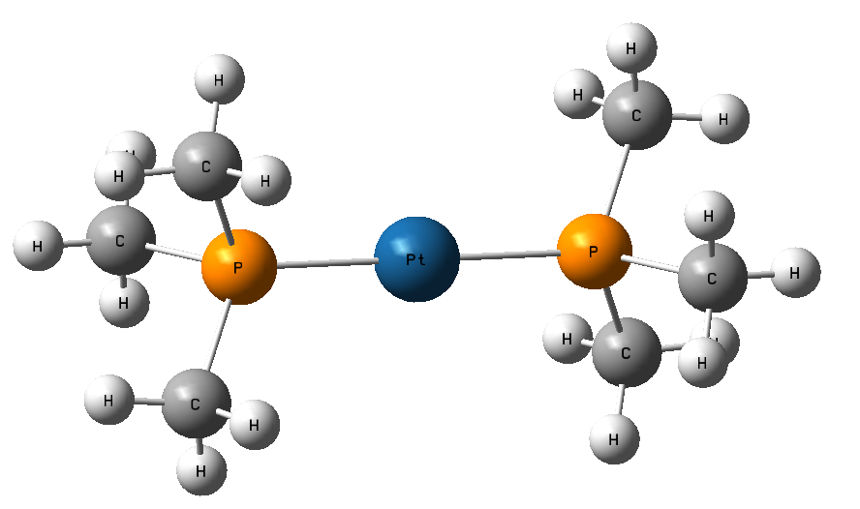
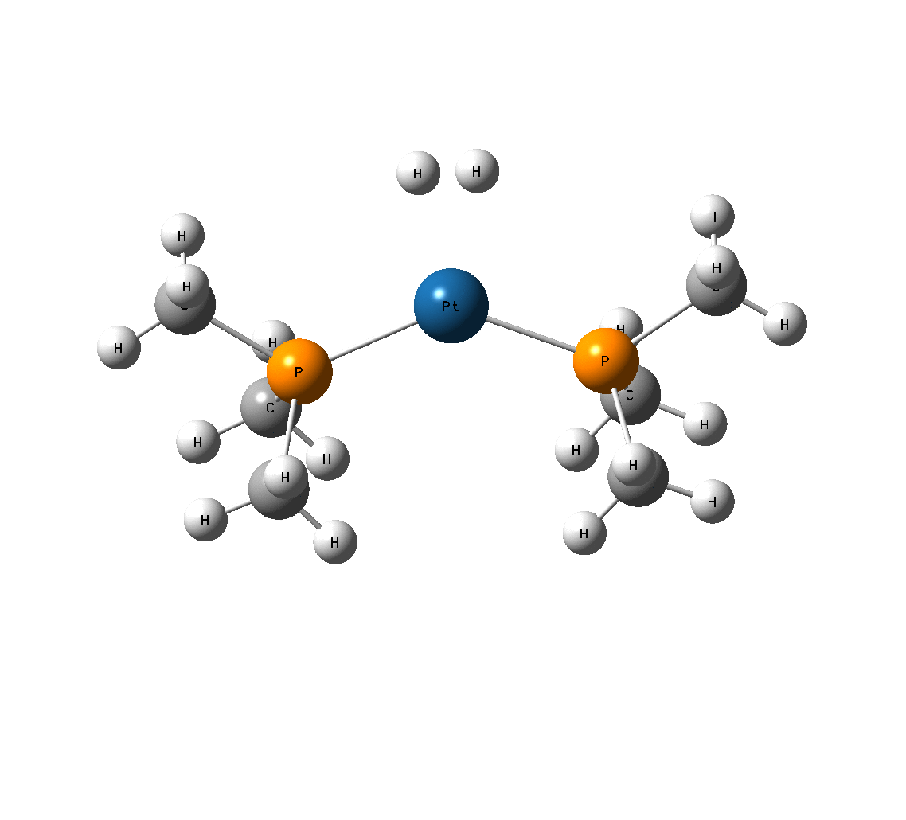
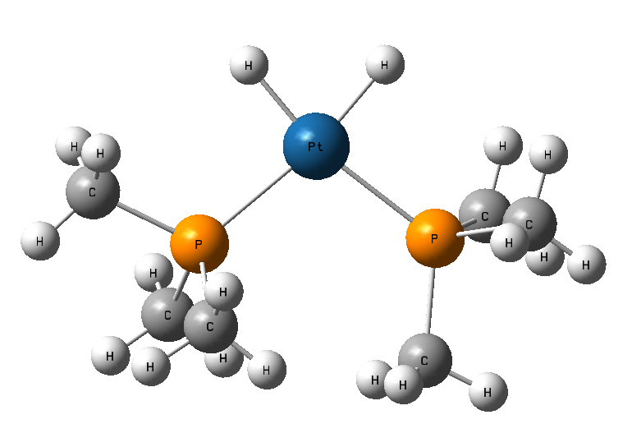
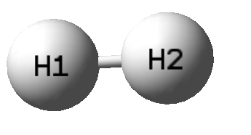
1.2 Optimized Geometries
Reactant
TS
Product
1
+
3
2

Slide 4
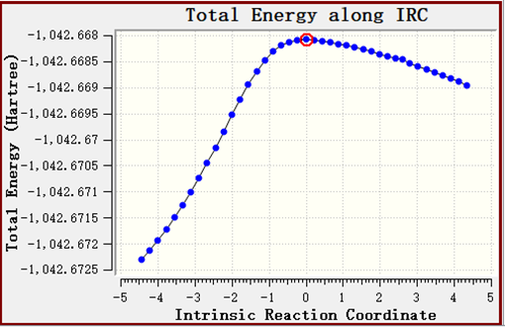
1.3 Gibbs Free Energy Profile

Slide 5
1.4 NBO Analysis
 | Reactant | TS | Product
Pt | -0.593 | -0.617 | -0.684
H₁ | 0.000 | 0.024 | -0.047
H₂ | 0.000 | 0.024 | -0.056

Slide 6
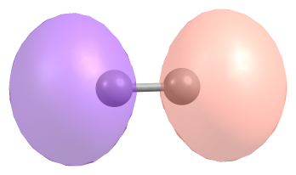
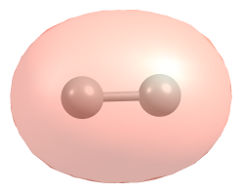
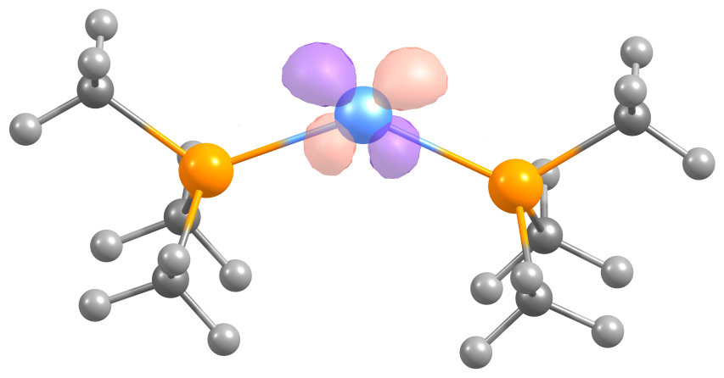
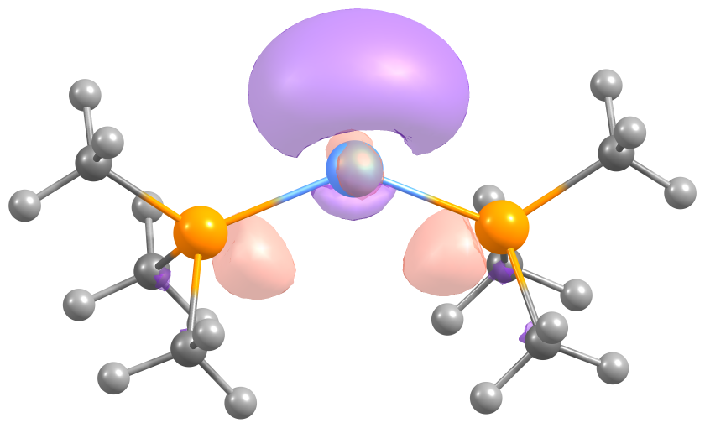
1.4 NBO Analysis
HOMO
1.818e
-11.51eV
LUMO
0.099e
2.27eV
HOMO 1.909e
-4.54eV
LUMO 0.198e
-0.43eV

Slide 7
2.1 H₂ Activation by PMe₃
Method : DFT&B3LYP with dispersion correction(GD3BJ)
Basis set : 6-311G**
Optimizations were performed in benzene solution.
Solvent effect was considered with SMD model.
Program : G16

Slide 8
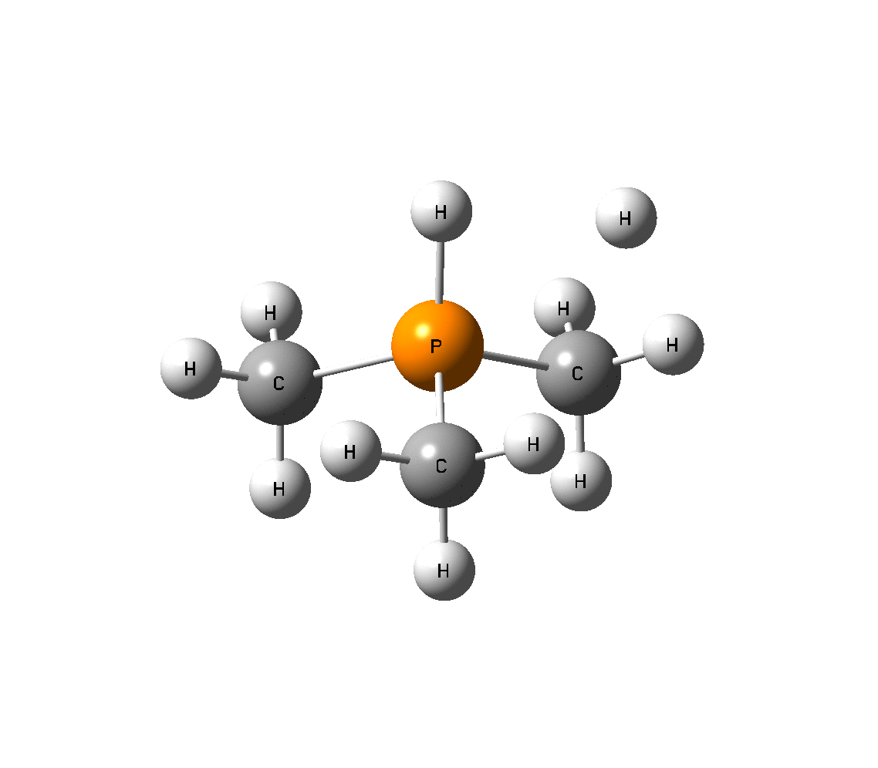
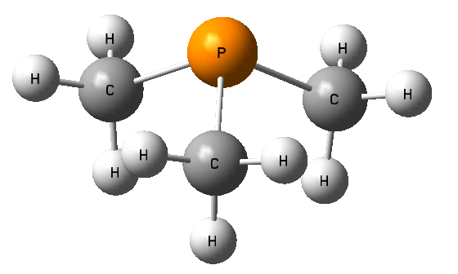
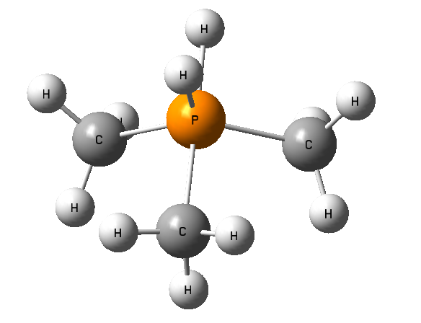
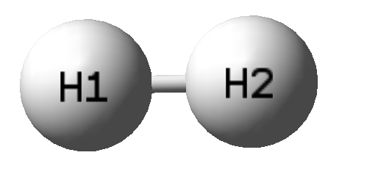
2.2 Optimized Geometries
Reactant
TS
Product
1
+
3
2

Slide 9

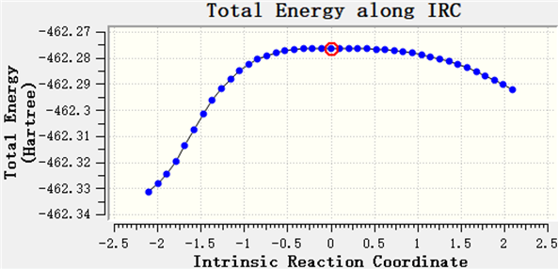

2.3 Gibbs Free Energy Profile
+

Slide 10
2.4 NBO Analysis
 | Reactant | TS | Product
P | 0.743 | 1.280 | 1.139
H₁ | 0.000 | 0.093 | -0.067
H₂ | 0.000 | -0.880 | -0.260

Slide 11
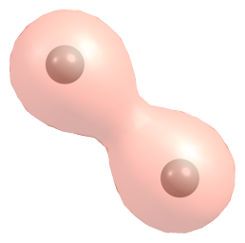
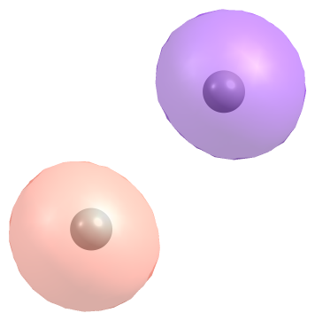
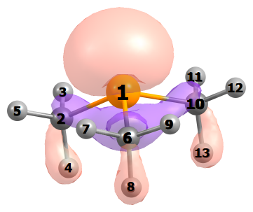
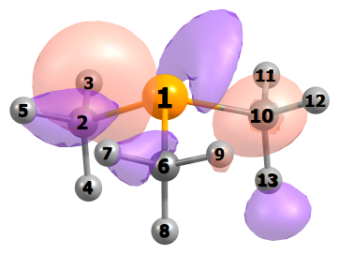
2.4 NBO Analysis
HOMO
1.515e
-8.09eV
LUMO
1.057e
-4.28eV
LUMO+1
0.131e
1.67eV
HOMO
1.106e
-5.18eV

Slide 12
3.1 H₂ Activation by NHC
Method : DFT&B3LYP with dispersion correction(GD3BJ)
Basis set : 6-311G**
Optimizations were performed in benzene solution.
Solvent effect was considered with SMD model.
Program : G16

Slide 13
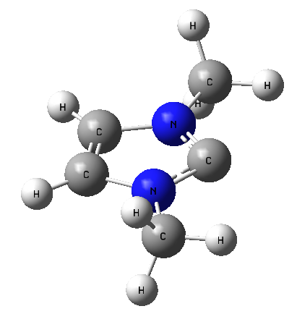
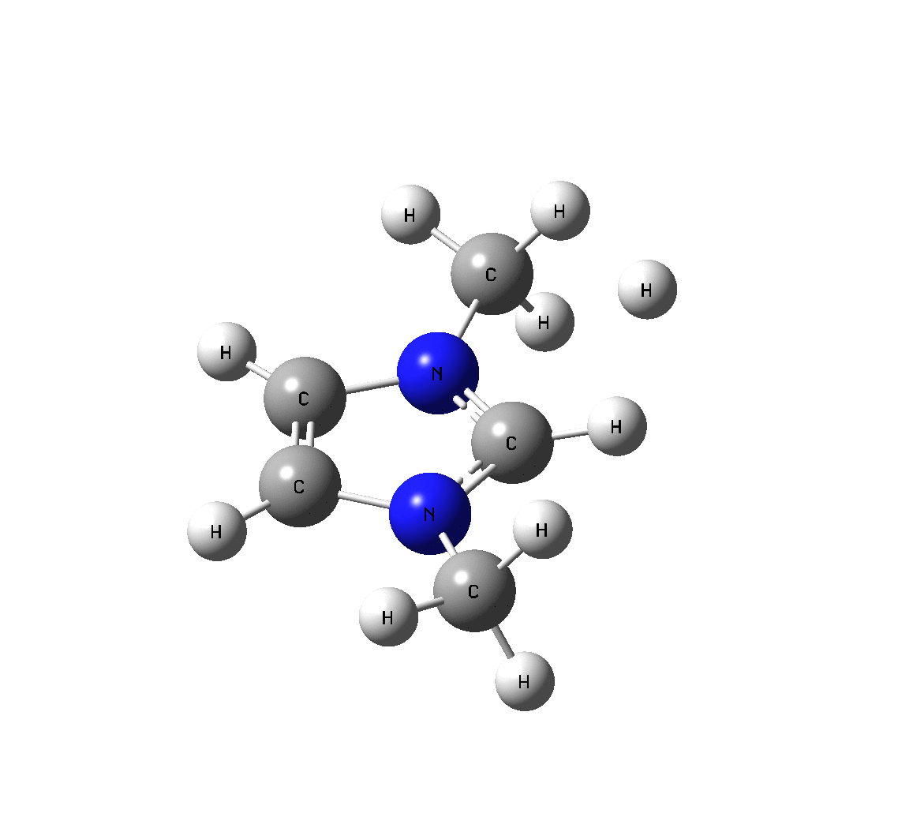
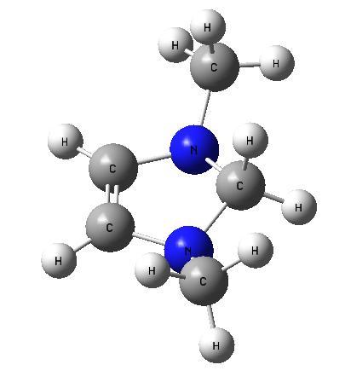
3.2 Optimized Geometries
Reactant
TS
Product
H₂
H₂
C₁
H₁
C₁
H₁
1
+
2
3

Slide 14

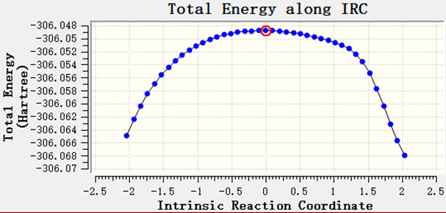

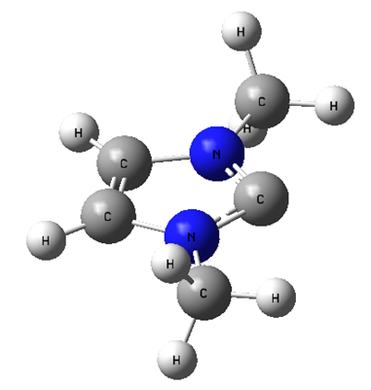
3.3 Gibbs Free Energy Profile
+

Slide 15
3.4 NBO Analysis
 | Reactant | TS | Product
C₁ | 0.055 | 0.268 | 0.043
H₁ | 0.000 | 0.286 | 0.180
H₂ | 0.000 | -0.818 | 0.120

Slide 16
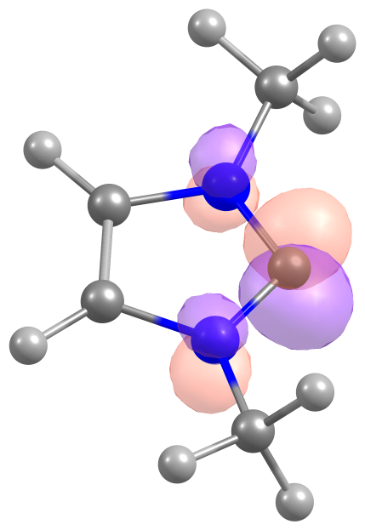
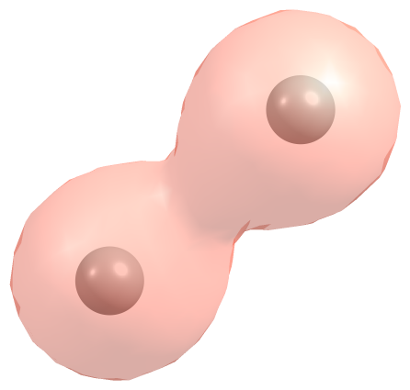
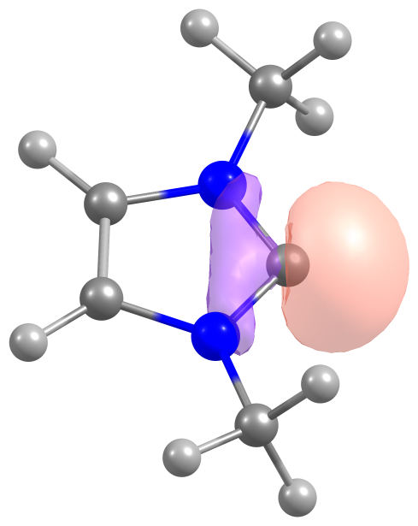
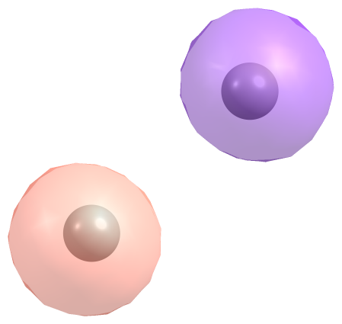
3.4 NBO Analysis
HOMO
1.535e
-0.30eV
LUMO
0.936e
-0.15eV
LUMO
0.205e
-0.04eV
HOMO
1.229e
-0.20eV

Slide 17
Thanks for your attention!

